Slide 1
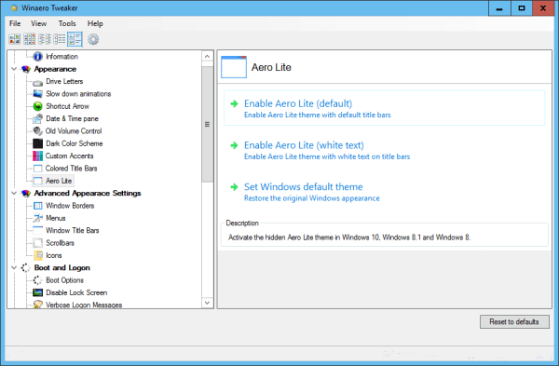
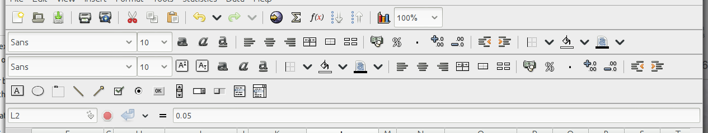

Machine
File Edit Graphplot Math Tools Help
LED Light
UV Light
IR Light
Exhaust
Sterile
Cycle
Reaction Container
UV Light
LED Light
IR Light
General setup
Heater/Stirrer
Heater/Sonicator
Electrochemical module
Dispenser
Potentiostat
Procedures Library
New Procedures
User defined Procedures
Data
Graph Plot
Modules
Status
Lights
START
PAUSE
STOP
RESUME
Air temp:
Relative humidity:
Input: V
Input AC frequency: Hz
Cooling fan status: Running/Stopped
Door status: Closed/Open
Ultraviolet Light
Time: ___
Run throughout the procedure
Infrared Light
Time: ___
Run throughout the procedure
Estimated total runtime: 32 minutes
UV Light
(15m)
CA
CV
Wait
(10s)
END
ADD
IR Lights
ADD

Slide 2
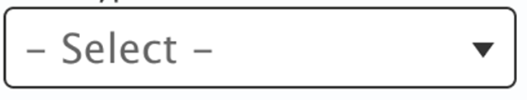

Machine
File Edit Graphplot Math Tools Help
LED Light
UV Light
IR Light
Exhaust
Sterile
Cycle
Reaction Container
UV Light
LED Light
IR Light
General setup
Heater/Stirrer
Heater/Sonicator
Electrochemical module
Dispenser
Potentiostat
Procedures Library
New Procedures
User defined Procedures
Data
Graph Plot
Status
Preinstalled Libraries
START
PAUSE
STOP
RESUME
Air temp:
Relative humidity:
Input: V
Input AC frequency: Hz
Cooling fan status: Running/Stopped
Exhaust system:
Door status: Closed/Open
Selected Library:
Reaction container size
Wait time.: ______ m
Materials.:
Ag Electrode.:
Solvent.:
Estimated total runtime: 32 minutes
S. No. | Procedure | Details
1 | Silver nanoparticles (Ag), APS: ~50 nm, Functionalization: NIL, Morphology: Spherical
2 | Silver nanoparticles (Ag) PEG coated, APS: ~50 nm, Functionalization: PEG, Morphology: Spherical
3 | Silver nanoparticles (Ag) PVA coated, APS: ~50 nm, Functionalization: PVA, Morphology: Spherical
4 | Iron Oxide Nanoparticles (Fe₃O₄), APS: ~25 nm, Functionalization: NIL, Morphology: Spherical
5 | Nanocomposite Iron Oxide Nanoparticles (Fe₃O₄) @ MWCNT , APS: ~25 nm, Av OD CNT: 20nm, Functionalization: NIL, Fe₃O₄ Morphology: Spherical
Modify Procedure v
ADD

Slide 3
Machine
File Edit Graphplot Math Tools Help
Settings
Main Heater
Options
General setup
Heater/Stirrer
Heater/Sonicator
Electrochemical module
Dispenser
Potentiostat
Procedures Library
New Procedures
User defined Procedures
Data
Graph Plot
Status
Heater/Stirrer
START
PAUSE
STOP
RESUME
Air temp:
Relative humidity:
Input: V
Input AC frequency: Hz
Cooling fan status: Running/Stopped
Exhaust system:
Door status: Closed/Open
Current temp.: ______ ºC
Set temp.: ______ ºC
Stirring: ON/OFF
RPM: ________
Estimated total runtime: 32 minutes
UV Light
(15m)
Dispense
(500 ml)
Stirring
500 RPM
(3h)
EC
V=3V
(5m)
Wait
(10s)
END
Main heater
(80ºC)
ADD

Slide 4
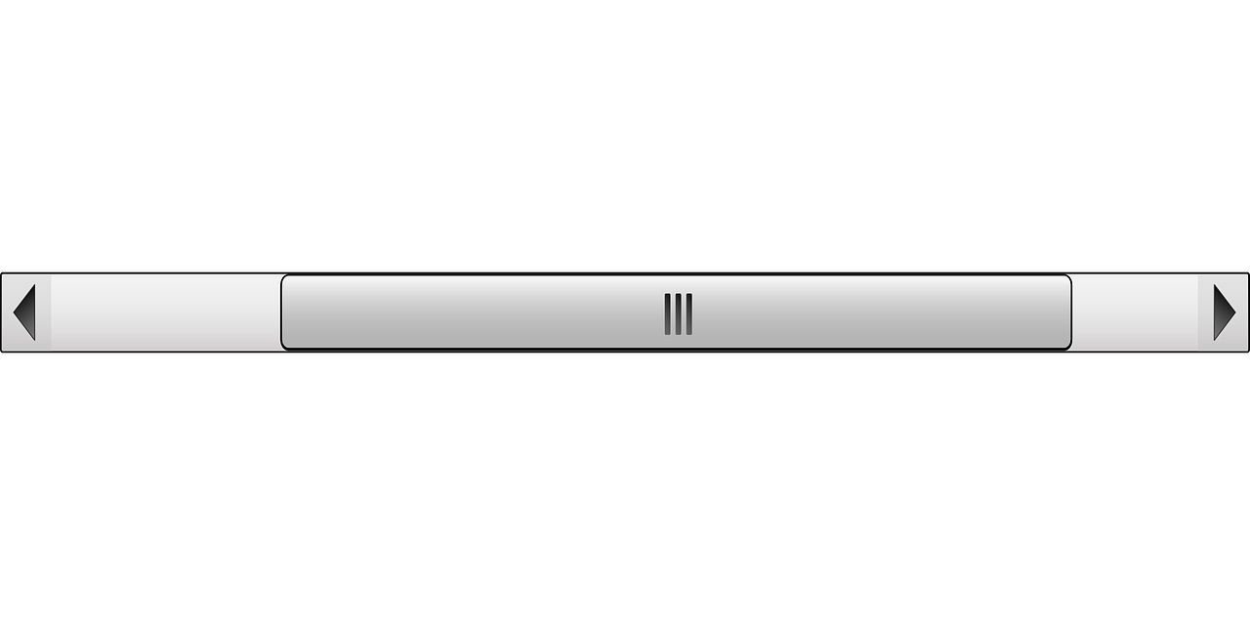
Machine
File Edit Graphplot Math Tools Help
Settings
Main Heater
Options
General setup
Heater/Stirrer
Heater/Sonicator
Electrochemical module
Dispenser
Potentiostat
Procedures Library
New Procedures
User defined Procedures
Data
Graph Plot
Status
Dataset/Results
Workbook (Silver nanoparticles (Ag), NC4563)
Air temp:
Relative humidity:
Input: V
Input AC frequency: Hz
Cooling fan status: Running/Stopped
Exhaust system:
Door status: Closed/Open
Procedure name:
Datasets to display:
Format:
Time (s) | Temp (ºC) | Current (A) | Volt (V) | UV Illumination | Sonication
0.5 | 65.46 | 6.4 | 03.45 | ON | OFF
1.0 | 64.89 | 6.3 | 03.29 | ON | OFF
1.5 | 65.78 | 6.7 | 03.35 | ON | OFF
2.0 | 66.35 | 6.2 | 03.89 | ON | OFF
2.5 | 65.98 | 6.3 | 03.48 | ON | OFF
3.0 | 65.49 | 6.4 | 03.37 | ON | OFF
3.5 | 64.69 | 6.2 | 03.95 | ON | OFF
4.0 | 65.15 | 6.5 | 03.85 | ON | OFF
4.5 | 66.20 | 6.6 | 03.38 | ON | OFF
4.5 | 66.20 | 6.6 | 03.38 | ON | OFF
Export
Plot

Slide 5
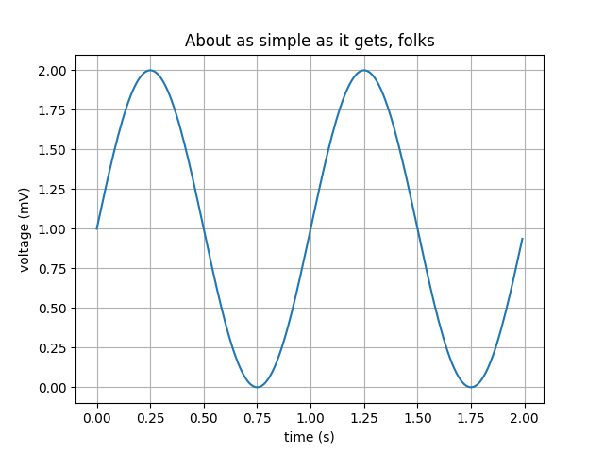
Machine
File Edit Graphplot Math Tools Help
Settings
Main Heater
Options
General setup
Heater/Stirrer
Heater/Sonicator
Electrochemical module
Dispenser
Potentiostat
Procedures Library
New Procedures
User defined Procedures
Data
Graph Plot
Status
Graphplot
Air temp:
Relative humidity:
Input: V
Input AC frequency: Hz
Cooling fan status: Running/Stopped
Exhaust system:
Door status: Closed/Open
Procedure name:
Plot coordinates:
Plot: Voltage (V) Vs Time (s)
Math Functions v
Image Export v
Select

Slide 6
Machine
File Edit Graphplot Math Tools Help
LED Light
UV Light
IR Light
Exhaust
Sterile
Cycle
Reaction Container
General setup
Heater/Stirrer
Heater/Sonicator
Electrochemical module
Dispenser
Potentiostat
Procedures Library
New Procedures
User defined Procedures
Data
Graph Plot
Status
Heater/Stirrer
START
PAUSE
STOP
RESUME
Air temp:
Relative humidity:
Input: V
Input AC frequency: Hz
Cooling fan status: Running/Stopped
Exhaust system:
Door status: Closed/Open
Current temp.: ______ ºC
Set temp.: ______ ºC
Stirring: ON/OFF
RPM: ________
Estimated total runtime: 32 minutes
UV Light
(15m)
Dispense
(500 ml)
Stirring
500 RPM
(3h)
EC
V=3V
(5m)
Wait
(10s)
END
Main heater
(80ºC)
ADD

Slide 7



Machine
File Edit Graphplot Math Tools Help
Methods
Standards
Options
Reaction Container
General setup
Heater/Stirrer
Heater/Sonicator
Electrochemical module
Dispenser
Potentiostat
Procedures Library
New Procedures
User defined Procedures
Data
Graph Plot
Modules
Status
Potentiostat
Air temp:
Relative humidity:
Input: V
Input AC frequency: Hz
Cooling fan status: Running/Stopped
Door status: Closed/Open
Cyclic Voltametry (CV)
Current range (uA): ____
Sample rate (Hz): ____
Quiet time (s): ____
Quiet value (V): ____
min value (V): ____
max value (V): ____
scan rate (V/s): ____
Number of cycles: ____
Start minimum
Start maximum
Cyclic Voltammetery
Square Wave Voltammetry
Linear Sweep Voltammetry
ADD

Slide 8
Machine
File Edit Graphplot Math Tools Help
Constant Current
Constant
Voltage
Options
EC module
Status
General setup
Heater/Stirrer
Heater/Sonicator
Electrochemical module
Dispenser
Potentiostat
Procedures Library
New Procedures
User defined Procedures
Data
Graph Plot
Modules
Status
Electrochemical module
START
PAUSE
STOP
RESUME
Air temp:
Relative humidity:
Input: V
Input AC frequency: Hz
Cooling fan status: Running/Stopped
Door status: Closed/Open
Voltage (V): ____
Current (Amps): ____
Time: ____
Estimated total runtime: 32 minutes
UV Light
(15m)
CA
CV
Wait
(10s)
END
IR Lights
ADD

Slide 9

Machine
File Edit Graphplot Math Tools Help
Wave Scan
Thickness
Quanti
fication
Kinetics
Options
UV Lamp
VIS Lamp
Status
v
v
v
General setup
Heater/Stirrer
Heater/Sonicator
Electrochemical module
Dispenser
Potentiostat
Procedures Library
New Procedures
User defined Procedures
Data
Graph Plot
Modules
Status
Wavelength Monitoring
Air temp:
Relative humidity:
Input: V
Input AC frequency: Hz
Cooling fan status: Running/Stopped
Door status: Closed/Open
Data Type:
Sampling:
Mode:
Wavelength Monitoring
Thickness
Multi Component Analysis
Experiment Setup v
Baseline Correction v
ADD

